Slide 1
Data-Driven Statistical Models for Assessing Climate Change Impacts on Agriculture Odisha, India
Analyzing the Role of Rainfall & Temperature on Agricultural Productivity
Presented by: Aryan (22051757), Amitesh (22051745), Ayush Pandey (22051762), Ansuman Mishra (22052007), Ashish Kumar (22052015), Aniket Dey (22052006)

Slide 2
Introduction
Agriculture is a crucial sector in Odisha, with the KBK (Kalahandi, Bolangir, and Koraput) districts heavily dependent on rain-fed farming. However, climate variability, particularly erratic rainfall and rising temperatures, has significantly affected crop production. This study explores the correlation between climate variability and crop yield, with a focus on rice and maize. The objective is to analyze historical trends, assess challenges, and propose adaptation strategies for sustainable agriculture in the region.

Slide 3
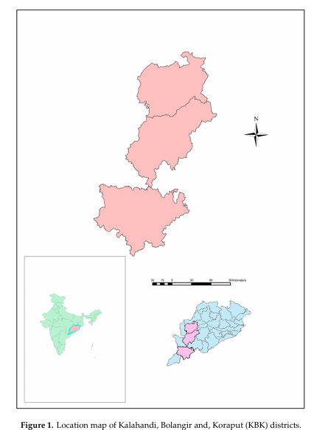
Study Area
Location: Southern and Western Odisha
Key Characteristics:
Kalahandi: High agricultural dependency, frequent droughts.
Bolangir: Prone to water scarcity, unreliable irrigation.
Koraput: Diverse topography, varying climatic conditions.
Why KBK districts?
These areas are among the most vulnerable to climate change due to their reliance on monsoonal rainfall.

Slide 4
Data Sources
Meteorological Data: Rainfall and Temperature (1980-2017) from IMD.
Crop Productivity Data: Rice and Maize yield trends.
Climate Indices: Monsoon Index (MI), Oceanic Niño Index (ONI),and
NINO-3.
Additional Sources: Government agricultural reports, farmer surveys, and climate research studies.

Slide 5
Methodology
Data Processing and Variables
Dependent Variables: Crop yield anomalies for rice and maize.
Independent Variables: Rainfall anomalies, temperature anomalies, and climate indices (MI, ONI, NINO-3).
Data Pre-processing:
Removal of missing values.
Normalization of climatic data for better comparison.
Five-year running mean calculation to identify significant trends.

Slide 6
Methodology
The methodology involves mathematical and statistical techniques to quantify the relationship between climate variables and crop yield.
Crop Yield Anomaly Calculation: y’={(y-y’’)/y’’} x 100 Where:
Y = Annual crop yield / area / rainfall.
Y’’= Five-year running mean.
Y’ = Anomaly of the variables like crop yield, rainfall, temperature.
Simple Linear Regression Model: I = α + βE + ε Where:
I = Dependent variable (crop yield anomaly).
E = Independent variable (rainfall/temperature anomaly).
α = Intercept.
β = Coefficient representing effect size.
Multiple Linear Regression for Combined Impact: I = α + βE + ε + γ X + ε Where:
X = Additional climate variables (e.g., monsoon index).
γ = Effect of additional climatic factors.

Slide 7
Methodology
Climatic Indices and Their Role
Several climate indices were used to assess their impact on rainfall and, consequently, crop yield:
Monsoon Index (MI): Measures the strength of monsoon winds affecting Indian summer rainfall.
MI=U850(40°E-80°E,5° N-15 °N) – U850(70° E-90° E,20° N-30° N)
Higher values indicate stronger monsoons, leading to better crop yield.
Oceanic Niño Index (ONI) and NINO-3:
These indices measure sea surface temperature anomalies in the Pacific Ocean, which impact Indian monsoons.
Stronger El Niño events correlate with weaker monsoons and reduced agricultural productivity.
These methodologies help identify key factors affecting agricultural production in KBK districts and allow for predictive modeling of future climate risks.

Slide 8
Climatic Variability Trends
Over the past decades, rainfall in KBK districts has become increasingly erratic. Some years have experienced excessive monsoonal rain, leading to floods, while others have faced prolonged dry spells, causing droughts. Temperature trends also show a gradual increase, particularly in the summer months, leading to faster soil moisture depletion and heat stress on crops.
Key Observations:
Rainfall variability has increased crop failure risks.
Higher temperatures reduce soil fertility and water retention.
Visual Representation: Graphs of historical rainfall and temperature variations (1980-2017).

Slide 9
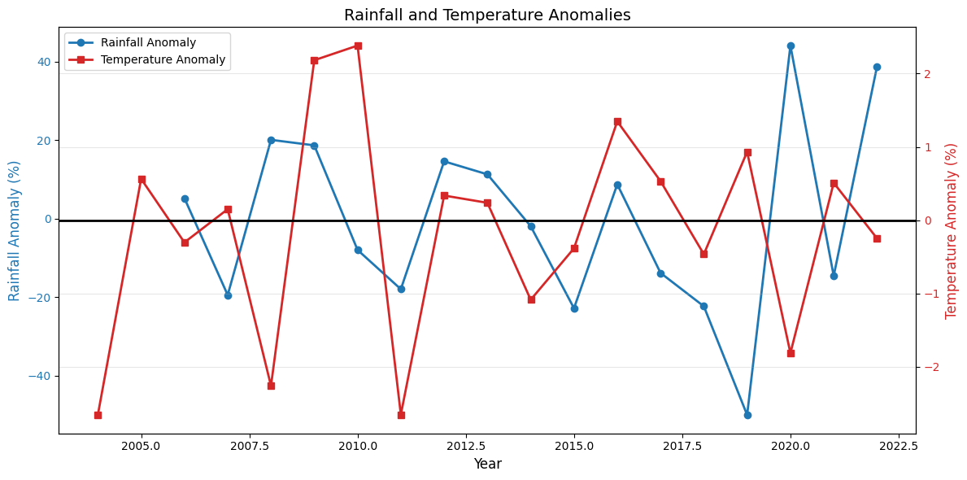

Slide 10
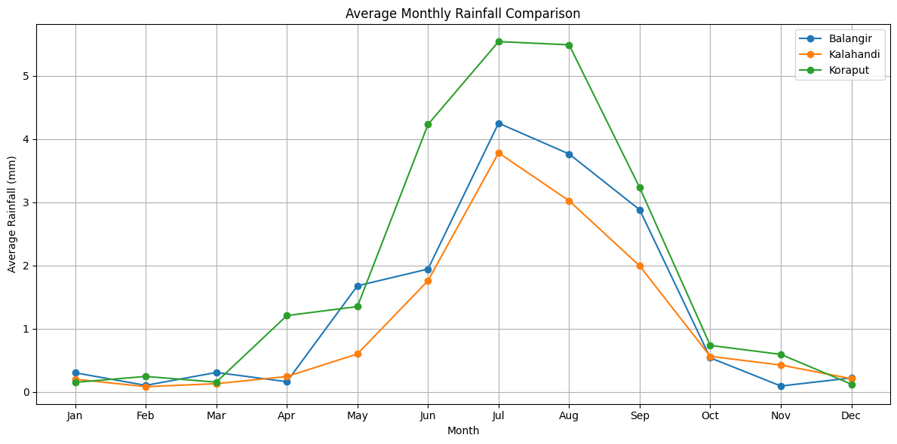

Slide 11
Impact of Rainfall & Temperature on Crop Yield
Rainfall Influence:
A strong positive correlation is observed between monsoon rainfall and rice/maize yield.
Drought years have led to a sharp decline in yield.
Flooding due to excessive rainfall has also damaged crops.
Temperature Influence:
Rising temperatures correlate negatively with yield.
Increased evaporation reduces soil moisture, impacting germination and growth.
Findings: Rainfall has a more significant impact than temperature variations on yield fluctuations.

Slide 12
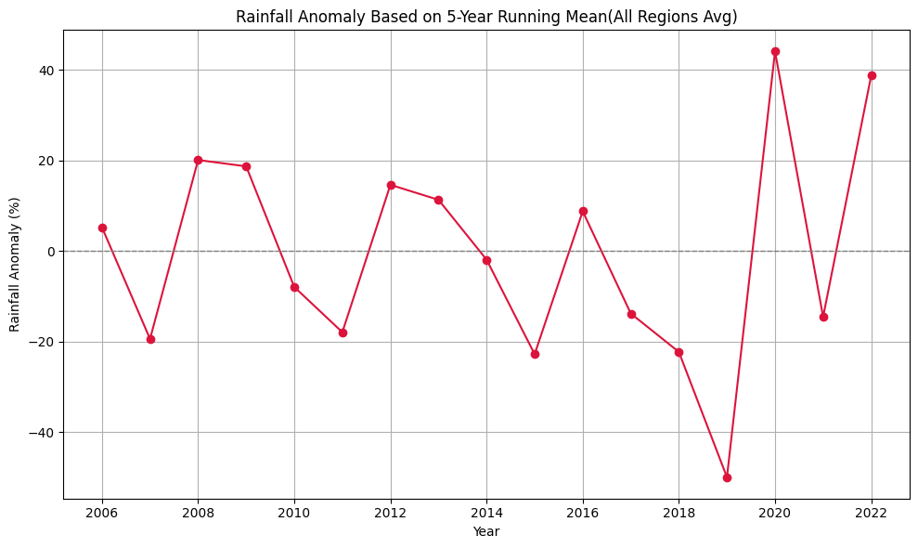

Slide 13
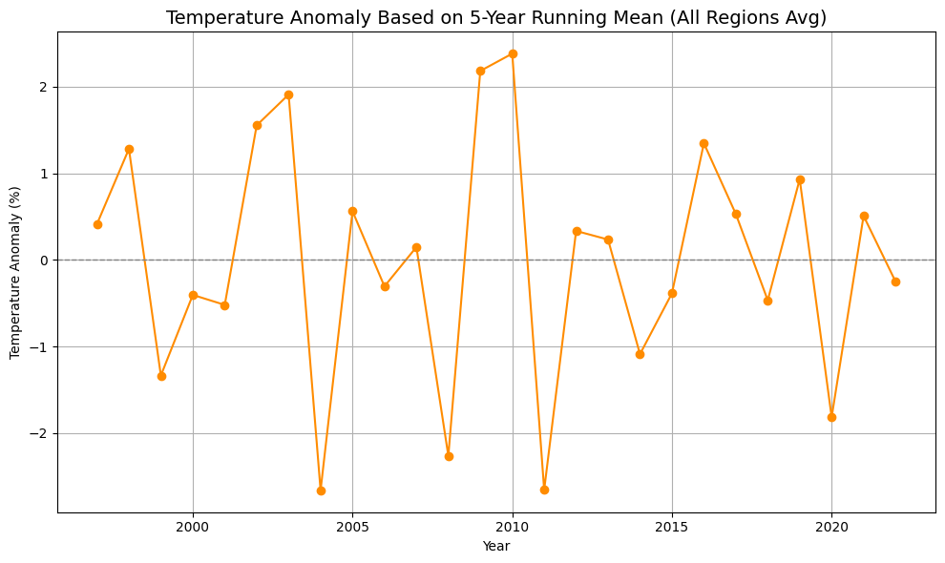

Slide 14
Role of Monsoon Index & Climate Indices
The Monsoon Index (MI) is crucial in predicting agricultural output. High MI values correspond to increased rainfall and better yields, while low MI values indicate drought risks. Additionally, the ONI and NINO-3 indices, which track El Niño and La Niña events, show moderate correlations with rainfall variability in Odisha.
Key Takeaways:
Strong monsoons result in increased agricultural productivity.
Weak monsoons and El Niño events often lead to droughts and lower crop yields.
Statistical Data: Correlation values and regression analysis of climate indices.

Slide 15
Challenges Faced by Farmers
Farmers in KBK districts are increasingly vulnerable due to unpredictable climatic conditions. The major challenges include:
Frequent Droughts & Floods: Leading to inconsistent yields.
Erratic Rainfall: Disrupting sowing and harvesting cycles.
Limited Irrigation Facilities: Increasing dependency on monsoons.
Economic & Social Impact: High debts, migration, and reduced food security.

Slide 16
Farmers' Perception & Adaptive Strategies
A survey conducted among local farmers reveals growing concerns about climate change. Nearly 70% of respondents reported erratic rainfall, while 60% cited temperature increases as a threat to crop production.
Adaptation Strategies:
Crop Diversification: Farmers are shifting to drought-resistant crops.
Water Conservation Techniques: Adoption of rainwater harvesting and micro-irrigation.
Adjusting Sowing Periods: Changing planting times based on monsoon forecasts.
Need for Government Support: Better climate-adaptive policies and financial aid for sustainable farming.

Slide 17
Conclusion & Recommendations
The study confirms that climate variability, particularly rainfall fluctuations, significantly impacts crop yield in KBK districts. Rising temperatures further exacerbate soil degradation, leading to decreased productivity.
Recommendations for Sustainable Agriculture:
Enhance Irrigation Systems: Reduce dependency on monsoons by implementing efficient irrigation techniques.
Improve Climate Forecasting: Provide early warnings to farmers for better preparedness.
Promote Climate-Resilient Crops: Encourage cultivation of drought- and flood-resistant crops.
Financial Support & Insurance: Implement crop insurance and financial aid programs to support farmers during extreme weather events.

Slide 18
References & Acknowledgments
Author Contributions: Conceptualization, N.S. and S.B.; Data curation, A.P. and L.S.; Formal analysis, A.P. and N.S.; Methodology, A.P.; Supervision, N.S.; Visualization, L.S., R.A. and M.Y.; Writing—original draft, A.P.; Writing—review & editing, S.B., T.S., R.A., R.B.S.
Acknowledgments: We are thankful to the India Meteorological Department, Pune, for providing required data used in this research article and for their e ective response. We acknowledge software like ArcGIS, R used for making graphs in this article for their free downloading and availability of tutorials. We also acknowledge the library and computer centre facilities of University of Delhi for their prompt responses and available facilities. At present, Netrananda Sahu is working as JSPS Postdoc Fellow at DPRI, Kyoto University. We are thankful to JSPS (ID No. P18360), Japan.

